Slide 1
CS460 Systems for Data Management and Data Science
Query Execution
Prof. Anastasia Ailamaki
Data-Intensive Applications and Systems (DIAS) Lab
“It is better to have 100 functions operate on one data structure than to have 10 functions operate on 10 data structures”
– Alan Perlis

Slide 2
Today’s topic
Data science software stack
Data Processing
Transaction
Management
Graph Data
Pregel, GraphLab, X-Streem, Chaos
Structured Data
Spark SQL
Machine Learning
Gossip Protocols
Query Execution
Batch Data
Map Reduce, Dryad, Spark
Streaming Data
Storm, Naiad, Flink, Spark Streaming Google Data Flow
Consistency protocols
CAP Theorem
Data Storage
Storage Hierarchies & Layouts
Distributed File Systems
(GFS)
NoSQL DB
Dynamo
Big Table Cassandra
Distributed Messging systems
Kafka
Distributed/Decentralized systems
Ressource Management & Optimization
Query optimization
Scheduling (Mesos, YARN)
Notes:
With Orange, we denote more general topics that are applied across several systems and architectures, both in scale-up and scale-out deployments.

Slide 3

(Simplified) DBMS Architecture
Application Front Ends
Web Forms
SQL Interface
Memory
SQL Commands
Parser + Optimizer +
Plan Execution
Transaction
Manager
Recovery
Manager
Files and Access Methods
Buffer Management
Storage Management
Disk
Data
Notes:
Today’s topic is query execution

Slide 4
Zoom in: Query Planner/Optimizer/Executor
Query Optimizer
Cost Estimates
Abstract Syntax Tree
Logical Query Plan
Physical Query Plan
(Cost-based) Optimizer
Plan Executor
Parser
Planner
How the DBMS executes a query (plan)
Notes:
How we execute an end-to-end query and produce the final result to the user.

Slide 5
Query Plan
Operators are arranged in a tree.
Data flows from leaves to root.
Output of root = Query result.
Composable algebra => composable execution
Notes:
These are all the operators in our query plan. Given this query plan, how do we execute it.
And consider that this is a simple plan with a few operators. In practice, plans may have 10s or 100s of operators and the query plan is only known at runtime, so the engine should be able to execute arbitrary plans, fast.
Thankfully, relational algebra is already composable, so in this lecture we will see how the DBMS can 1. Execute such plans without loosing support for composability, 2. How it can do it efficiently to take advantage of the available hardware.

Slide 6
Processing model
The processing model of a DBMS defines how the system executes a query plan.
Different trade-offs for different workloads
Extreme I: Tuple-at-a-time via the iterator model
Extreme II: Block-oriented model (typically column-at-a-time)
Notes:
Processing model: how we organize the execution flow of the data between the operators. It specifies whether you are going from top to bottom, bottom to top, what you are passing from one operator to the next.
It depends on the environment, on the storage model.
There are two extremes and afterwards, we will also see some intermediate approach. Each extreme has different trade-offs and different performance implications for different workloads. The most common one is the iterator model.

Slide 7
Iterator Model (Volcano Model)
Each query operator implements a next function.
On each invocation, the operator returns either a single tuple or a marker that there are no more tuples
next calls next on the operator’s children to retrieve and process their tuples
class Operator:
Optional<Tuple> next()
class Filter:
Operator input, Expression pred
Optional<Tuple> next():
while (true): t = input.next()
if (t empty or pred(t)) return t
class Project:
Operator input, Expression proj
Optional<Tuple> next():
t = input.next()
if (t empty) return empty
return proj(t)
Common operator interface => composability
Notes:
The first processing model we will see is the iterator model, or alternatively the volcano or pipeline model, which is one of the oldest and simplest approaches adopted for query execution.
In this model, all operators implement the same interface: they have a next function that, when called, returns the next tuple, if any – otherwise it returns a special marker/value to notify the parent operator that there are no more tuples.
Typically, for an operator to produce (as a result of a call to next) an output tuple, it has to retrieve tuples from its children. Consider the project operator: to output a tuple, it has to retrieve a tuple from its input and apply a projection expression (e.g., proj{ c = a+b, d = a-b } ) to compute a new tuple. Similarly, a filter operator retrieves tuples from its child until it finds one that passes the predicate.
As a result, next() often calls next() on the children to retrieve and process their tuples – and this cascades down from, i.e. from the root to the leaf nodes.
As a result, each tuple that is returned by the leaves is propagated as far as possible from the bottom to the top of the tree, before we move to the next one – giving the alternative name of this model, the “pipeline model”.
To see that with an example, the top code snippet shows how an operator looks like, while the bottom two classes show examples of two simple operators. Each of them has some additional information (e.g. its child and an expression) and implements the next function that contains the main operator logic.
Notice how neither of these two operators specifies the type of the input: they just know it’s an operator and it has a next function.
Then if we look into the project class, the implementation of its next function is simple: it retrieves a tuple from the input operators, and except if the input operator signaled that it doesn’t have any more tuples (t empty), then we return the result of applying a projection expression into the retrieved tuple.
Similarly, the filter class iterates over the tuples produced by its input, until there is a tuple satisfying the predicate or there are not more tuples.
Note that in both cases, the only information known to these operators about their input is that it has the next function, but it could as well be that the input of a project is a filter, a join or even another project.
This allows complex plans to be composed.

Slide 8
Notation
class Operator:
Optional<Tuple> next()
class Operator:
generator<Tuple> Next()
class Filter:
Operator input, Expression pred
Optional<Tuple> next():
while (true): t = input.next()
if (t empty or pred(t)) return t
class Filter:
Operator input, Expression pred
generator<Tuple> next():
for t in input.Next():
if pred(t) emit t
class Project:
Operator input, Expression proj
Optional<Tuple> next():
t = input.next()
if (t empty) return empty
return proj(t)
class Project:
Operator input, Expression proj
generator<Tuple> Next():
for t in input.Next():
emit proj(t)
Notes:
To simplify the notation, we will be using for the rest of the lecture a co-routine based notation, where instead of a normal function, the next() will be a coroutine that “emits” tuples, instead of returning one after the other. This also makes more explicit that operators go over multiple tuples.

Slide 9





Example: Iterator Model
Notes:
So let’s see a full plan example. Using the same join query & execution plan as before, the are going to be two Scan operators (bottom), then a Filter on top of Scan(B), followed by a Join and a Projection.
This is the pseudocode showing the different next functions for the operators of the plan.
They are for loops that are iterating over the output of their child operator.
If we start from the root (the projection) it has a for loop which iterates over each tuple of the child that it gets from next and does the projection.

Slide 10
Example: Iterator Model (cont)
1
2
4
3
5
Notes:
From the projection If I call child.Next() I call the next of the child (the join operator).
The join operator is composed of 2 parts. It is a hash join that has the build phase that builds the hash table and the probe phase that probes the hash table.
Similarly, when I call left.Next in the join operator, it will invoke the function next on the child. Now we got into the leaf node where we have the access method, i.e., we access tuples either from the index or from the table.
From each emit function we are passing a single tuple as a return result for the invocation of next. We keep iterating over the tuples until we reach the end where we pass a null pointer and the parent knows that I’ve got everything from my child and I don’t need to go back at it again.
It is called iterator model because our cursor iterates over the tuples one by one.
Now, there is one think we ignored until now: except from the operators, we also had the expressions! In this example the evalPred and projection. These can also be arbitrary expressions, like the B.value > 100 here, but also more complex algebraic expressions. How do we make those composable and flexible as well?

Slide 11
(Interpreted) Expression Evaluation
class Filter:
Operator input
Expression pred = (B.c = B.d) AND (B.value > 100)
generator<Tuple> next(): …
SELECT A.id, B.value FROM A, B WHERE A.id = B.id
AND B.c = B.d AND B.value > 100
Nodes in the tree represent different expression types:
Comparisons (=, <, >, !=)
Conjunction (AND), Disjunction (OR)
Arithmetic Operators (+,-,*,/,%)
Constant Values
Tuple Attribute References
AND
=
>
Attribute(B.c)
Attribute(B.d)
Attribute(val)
Constant(100)
Notes:
How do we actually evaluate predicates? The where clauses, the join clauses.
We use a similar method. All expressions abide to the same interface: a single function that returns the result of evaluating the expression on a tuple.
Specifically, we represent the filter clauses as an expression tree. The nodes of the expression tree represent the different types of expressions that we have in our predicates. For example, comparisons, conjunction, disjunction, arithmetic operators, …. are represented in a tree.
In the example, the join clause and the where clause are represented as a tree. In this example, the root is the AND, and then we have the expressions for join and where clause.
Just like in the query plan where we go top to bottom, we do the same here to determine whether a tuple matches. We go down in a depth-first-search manner and we move values up.

Slide 12
Interpreted, tuple-at-a-time processing
The DBMS traverses the tree. For each node that it visits, it has to figure out what the operator needs to do. Same for expressions.
This happens for every… single… tuple…
Many function calls
Save/restore contents of CPU registers
Force new instruction stream in the pipeline → bad for instruction cache
Generic code
Has to cover every table, datatype, query
Notes:
As the type on the input operator is unknown at compile time (we want to be composing arbitrary operator trees), every call to next is an indirect function call. Same when evaluating expressions: every function call to evaluate an input expression is an indirect function call.
This effectively means that for every tuple, the DBMS (and the hardware) have to figure out what the operators and the expressions have to do – and that ignored type-checks and other operations that happen during e.g., expression evaluation because e.g., the same add expression applies for both integers and numerics.
This continuous interprepratation creates high overheads: every time an indirect function call happens, the compiler has to save and restore the registers into the stack and code locality is reduced as the function calls are indirect jumps that can’t be inlined (the compiler does not know the actual target function! It’s only known at runtime when the tree is formed).
So how can we use the hardware more efficiently?
NOTE: the indirect calls into next are hidden in the “coroutine” representation in the Next call and the emit.

Slide 13
Processing model
The processing model of a DBMS defines how the system executes a query plan.
Different trade-offs for different workloads
Extreme I: Tuple-at-a-time via the iterator model
Extreme II: Block-oriented model (typically column-at-a-time)
Notes:
The other extreme in the processing model spectrum aims on reducing these “interpretation” overheads.

Slide 14
Block-oriented (aka materialization) model
Each operator processes its input all at once and emits its output all at once
The operator “materializes” its output as a single result.
Often bottom-up plan processing.
class Operator:
Tuples Output()
class Filter:
Operator input, Expression pred
Tuples Output():
out = {}
for t in input.Output():
if pred(t) out.append(t)
return out
class Project:
Operator input, Expression proj
Tuples Output():
out = {}
for t in input.Output():
out.append(proj(t))
return out
Notes:
Instead of having a next function that returns a single tuple, each operator processes and returns all the tuples at once. It doesn’t call next multiple times and thus reduces the indirection calls from being per-tuple to being per-operator.
Note in these examples how the loops are “simpler”: there is a single call to get the full output from the input and then the operation happening in each loop is the same and thus the compiler and hardware only have to deal with a fixed, tight loop – increasing instruction locality and unnecessary instructions for interpreting at a per-tuple base.
Furthermore, the same holds for the evaluation of the expressions: in the same fashion, each expression node can be evaluated on the full input, before processing to the next one.
Lastly, note that the output of each operator can be either on a row or column format, having a subset of the total columns.

Slide 15

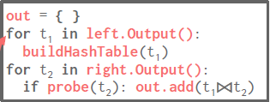



Block-oriented Model
5
4
3
2
1
Notes:
The return value is now an output buffer, which is a list of all tuples.
The top operator calls child.output which invokes the operator that is below.
Operator 1 scans and outputs all tuples, so there is no need to call it back again because it has given all tuples.

Slide 16
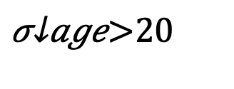


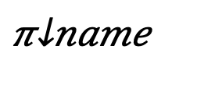
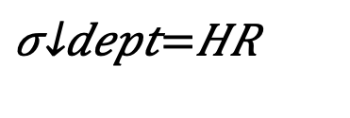
The (output) materialization problem – Naïve version
tbl
tid
1
Name
John
$$π_{name}$$
tid
1
2
3
Name
John
Jack
Jane
Age
22
19
37
Dept
HR
HR
IT
tid
1
$$⋈$$
SELECT Name FROM tbl
WHERE Age > 20
AND Dept = “HR”
tid
1
3
Age
22
37
tid
1
2
Dept
HR
HR
$$σ_{age>20}$$
$$σ_{dept=HR}$$
tbl
Notes:
The problem of block-oriented execution over a column store is when to stitch the tuples by combining different columns.
A naïve column store reads the columns relevant to the query operator, constructs tuples from their component attributes, and executes normal row-store operators on these rows to process (e.g., select, aggregate, and join) data. Although likely to still outperform the row-stores on analytical workloads like those found in data warehousing, this method of constructing tuples early in a query plan (“early materialization”) leaves much of the performance potential of column-oriented databases unrealized.
Of course there are many different implementations of early materialization. There might be a strategy that fetches the needed columns by the query and then evaluates the queries as in a row-store. Other approaches might fetch columns one at a time, evaluating predicates on them and then fetch from subsequent columns only those rowids that satisfied the prior predicates.
For example, in this query, after the execution of the select operators, the results are joined to compute the tuple ids that satisfy both operators. Then, the project operator reconstructs the result by bringing the Name column based on the ids of the tuples that satisfied the underlying select operators.

Slide 17

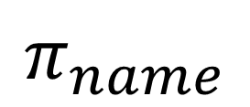
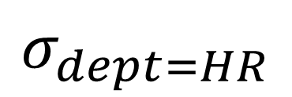
The (output) materialization problem – version 2
tbl
tid
1
Name
John
$$π_{name}$$
tid
1
2
3
Name
John
Jack
Jane
Age
22
19
37
Dept
HR
HR
IT
tid
1
$$σ_{dept=HR}$$
tid as extra filter to reduce output! Can we reduce it further?
SELECT Name FROM tbl
WHERE Age > 20
AND Dept = “HR”
tid
1
3
$$σ_{age>20}$$
tbl
Notes:
A better approach stiches the columns into rows as late as possible. Each time it emits only the tuple ids that satisfy an operator.
Then each subsequent query operator fetches columns on-demand. Each operator requires only the columns needed to evaluate the predicate it contains.
Every time we fetch the values of a column given a position list we perform a tuple reconstruction. Such actions have to be performed multiple times within a query plan, i.e., at least N - 1 times for each table, where N is the number of attributes of a given table referenced in a query (“payload”).
Tuple alignment across columns and enforcement of sequential access patterns reduces the costs of tuple reconstruction actions. For example, if each projection is sorted by one leading column, then a query which selects a range on this column immediately restricts its actions for tuple reconstruction to the range defined by the first selection. Since the projection is sorted on this attribute, this is a contiguous range on the projection, which in turn means that any tuple reconstruction actions take place only in a restricted horizontal partition.

Slide 18
The (output) materialization problem – selection vector
SELECT Name FROM tbl
WHERE Age > 20
AND Dept = “HR”
$$π_{name}$$
Name
John
bitmap
1
0
0
Only materialize bitmap
Perform calculations only for relevant tuples
$$σ_{dept=HR}$$
tbl
tid
1
2
3
Name
John
Jack
Jane
Age
22
19
37
Dept
HR
HR
IT
bitmap
1
0
1
$$σ_{age>20}$$
tbl
Notes:
Another similar approach of late materializations is that instead of emitting ids, each operator emits a bitmap. Hence the calculations will by applied only to the tuples with value 1 in the bitmap.

Slide 19

The (tuple) materialization problem
When joining tables, columns can get shuffled => Cannot use virtual ids => Stitching causes random accesses
tbl1.age
tid | Name
1 | John
3 | Jane
2 | Jack
tid | Age
1 | 22
2 | 19
3 | 37
$⋈$
tbl2.name=tbl1.name
tbl2
tbl1
The order of tbl1.name entries can change after the join!!!
Solution 1: Stitch columns before join
Solution 2: Sort list of tids before projection
Solution 3: Use order-preserving join algorithm (eg jive-join) – but not always applicable
Notes:
Late materialized joins can be problematic because tuples get shuffled. Then, to fetch other columns given shuffled tuple ids we need to do unordered positional lookups. For example in this case, after the join we keep the ids and then based on the ids we need to fetch the age column.
Unordered positional lookups are problematic since extracting values from a column in this unordered fashion requires jumping around storage for each position, causing significant slowdown -> random accesses.
There are several solutions to this. One is to stich columns a priori -> early materialization strategy relative to a join. Or sort the list of tids and then fetch the extra columns.
Another solution is to use order-preserving join algorithms such as the jive join. Jive-join range-partitions input relation tuple ids then processes each partition.

Slide 20

Block-oriented model
No next() calls -> no per-tuple overhead
Typically combined with columnar storage
Cache-friendly
SIMD-friendly
“Run same operation over consecutive data”
Avoid interpretation when evaluating expressions (in most cases)
Typically use macros to produce 1000s of micro-operators (!!!)
selection_gt_int32(int *in, int pred, int *out)
selection_lt_int32(int *in, int pred, int *out)
…
Output materialization is costly (in terms of memory bandwidth)
Notes:
Column-at-a-time operation, avoid multiple function calls.
Cache-friendly: cache performance is improved when operating directly on column data, since a given cache line is not polluted with surrounding irrelevant attributes for a given operation.
SIMD friendly: Light-weight compression schemes that compress a column into mostly fixed-width (smaller) values allow a compressed column to be treated as an array. Iterating through such an array can leverage the SIMD instruction set.
We can process multiple compressed values with one instruction as long as they are packed into fixed-width and dense arrays (that nicely fit into SIMD registers of modern processors), maximizing parallelism. Since column-stores exploit fixed-width dense arrays anyway, they can exploit SIMD execution even with uncompressed data.
Especially beneficial when running same operation over consecutive data. Sequential algorithms strongly favor block-at-a-time as memory accesses are dense regardless of whether a query touches all table columns. CPU detects the sequential pattern.

Slide 21
The beer analogy (by Marcin Zukowski): How to get 100 beers
Tuple-at-a-time execution:
Go to the store
Pick a beer bottle
Pay at register
Walk Home
Put beer in fridge
Repeat till you have 100 beers
Many unnecessary steps
Column-at-a-time execution
Go to the store
Take 100 beers
Pay at register
Walk Home
100 beers not easy to carry

Slide 22
Processing model
The processing model of a DBMS defines how the system executes a query plan.
Different trade-offs for different workloads
Extreme I: Tuple-at-a-time via the iterator model
Middle Ground: Vectorization model
Extreme II: Block-oriented model (typically column-at-a-time)

Slide 23
The middle ground: Vectorization model
Like iterator model, each operator implements a next function
Each operator emit a vector of tuples instead of a single tuple
Vector-at-a-time, aka “Carry a crate of beers at a time”!
The operator’s internal loop processes multiple tuples at a time.
Vector size varies based on hardware or query properties
General idea: Vector must fit in CPU cache
Notes:
the next() method of each operator returns a vector of N tuples as opposed to only a single tuple.
We re-design the operator implementations so that the for loop operates over a vector of tuples rather than a single tuple.
Vectorized execution combines pipelining (avoidance of materialization of large intermediates) with the array-loops code patterns that make MonetDB fast.
The typical size for the vectors used in vectorized processing is such that each vector comfortably fits in L1 cache

Slide 24
The middle ground: Vectorization model
Like iterator model, each operator implements a next function
Each operator emits a vector of tuples instead of a single tuple
class Operator:
Optional<Vector<Tuple>> next()
class Filter:
Operator input, Expression pred
Optional<Vector<Tuple>> next():
while (true): vec = input.next()
if (vec empty) return vec
out = {}
for t in vec:
if pred(t): out.add(t)
return out
class Project:
Operator input, Expression proj
Optional<Vector<Tuple>> next():
vec = input.next()
if (vec empty) return empty
out = {}
for t in vec:
out.add(proj(t))
return out
Notes:
Specifically, as you can see in the code snippets, the multiple tuples are returned per next call and the main loop for each operator does not have virtual function calls or indirect calls. As a result, instruction locality is improved and there is less risk for pipeline flushes in the CPU.
Lastly, the main loop of each operator can often be SIMD-ized: the loop body can be adapted to use SIMD instructions to reduce the number of instructions per tuple.

Slide 25

Vectorization model
Ideal for OLAP queries
Greatly reduces the number of invocations per operator
Allows for operators to use vectorized (SIMD) instructions to process batches of tuples
Basic model commercialized by
Notes:
Ideal for analytical queries. Analytical queries do long scans over large portions of a table, thus by getting a batch of tuples instead of a single tuple we reduce the number of next invocations.
As mentioned in the block-at-a-time, vectorized primitives which typically perform a tight loop over arrays, are amenable to some of the most productive compiler optimizations, and typically also trigger compilers to generate SIMD instructions.

Slide 26
Processing model
The processing model of a DBMS defines how the system executes a query plan.
Different trade-offs for different workloads
Extreme I: Tuple-at-a-time via the iterator model
Query compilation
Vectorization model
Extreme II: Block-oriented model (typically column-at-a-time)
Notes:
We have seen until now how to represent and execute complex plans, as well as how to amortize the cost of such plans by amortizing the cost of indirect function calls and operator linking across multiple tuples.
However, this is not the only way to avoid “interpretation” overheads. In the rest of today we will talk about query compilation: a technic that DBMS use to avoid indirection overheads by generating a specialized engine for each query.

Slide 27
Remark from Microsoft Hekaton
After switching to an in-memory DBMS, the only way to increase throughput is to reduce the number of instructions executed.
To go 10x faster, the DBMS must execute 90% fewer instructions
To go 100x faster, the DBMS must execute 99% fewer instructions
The only way to achieve such a reduction in the number of instructions is through code specialization.
Generate code that is specific to a particular task in the DBMS.
(Currently, most code is written to be understandable)
Notes:
Traditionally, the database systems have focused on minimizing disk IO. However, with the increase in size of main-memory, the data can be fit more easily in the memory itself. This led to the advent of in-memory database systems.
Now our goal is to improve the performance (say throughput or response time) of the in-memory system, especially for complex applications. How do we do it?
One way comes from an insight from Microsoft while building Hekaton, an in-memory OLTP database. While building Hekaton they realized that only way of improving the performance, given that there are no IOs, is by executing fewer instructions during plan execution. For example, if we want 10x faster, response time, then the DBMS must execute 90% fewer instruction; if we want 100x faster response time, then we need 99% fewer instructions.
How do we achieve this?
Ans: code specialization
Code specialization can help reduce the number of instructions executed. To give an example, if there are switch statements based on data type then it can be removed by hard-coding them. This is because the if-condition can be evaluated since the data type would be known upfront for this query.
Same principle holds with respect to the indirect calls between operators: instead of having the indirect call, after inspecting the query we can hardcode the exact linking.

Slide 28
Move from general to specialized code
CPU-intensive code parts can be natively compiled if they have a similar execution pattern on different inputs
Access Methods
Operator Execution
Predicate Evaluation
Goal: Avoid runtime decisions! Decide once, when you see the query plan!
Attribute types
=> (Inline) pointer casting instead of data access (virtual) function calls
Query predicate types
=> data comparisons
Notes:
Let’s start by diving into the details of what performance issues we have seen so far.
A major issue with iterator model is the generality of operator interface (next() function). While it increases composability, it also increases the number of function calls which is expensive and degrades the branch prediction of the CPU.
The idea of code specialization is to move such generic code to specialized code. In short, generate code for this ONE input query. This can be done by baking knowledge into code such as the sequence of operators, data types, exact predicates and their values, and so on. Apart from the data knowledge, before query execution, from the plan used for the query, we know the access method, operator algorithm that is executed for different scan or joins, attribute type and filter constants -- all this knowledge can also be hardcoded.
Also, if code is well specialized it avoids runtime decisions as much as possible.
1) Attribute types are known a priori: Instead of separate function calls, we can directly access tuples and their fields by pointer reference. Essentially, inline code as much as possible. By this, we further aid the compiler to optimize the generated code in ways that efficiently distribute data to registers and favor cache reuse.
2) We can perform data comparisons to evaluate predicates, so there is no need for function calls.
Thus, we can reduce the number of instructions executed.

Slide 29

Query Compiler
Query Optimizer
Logical Query Plan
Physical Query Plan
AST
Plan Rewriter
Plan Optimizer
Parser
Code Generator
Native Code
Notes:
How would we achieve such a solution given that the query is only known at runtime?
Zooming out, we would generate code after the physical query plan has been produced.
The query first goes through the parser where the query syntax is checked.
Query optimizer generates a plan – decides which scan, or join algorithm, or join order.
Once the plan freezes, a code generator will produce the to-be-executed code that is specialized to the query-at-hand.

Slide 30
Two approaches for code generation
Transpilation
DBMS converts a query plan into imperative source code
Compile the produced code to generate native code with a conventional compiler
JIT compilation
Generate an intermediate representation (IR) of the query that can be quickly compiled into native code.
Notes:
The code generation has followed two approaches.
Either to generate code through transpilation of JIT compilation.
In both techniques, when the query plan is ready, the engine creates specialized code for that query that hardcodes many of the things that are fixed after the query planning, such as the operator order that we already mentioned, or the fused expressions.
Specifically, transpilation is about source-to-source compilation meaning that the DMBS engine will generate source code in a high-level programming language, such as C++ which will further be compiled by a “normal” compiler to produce native code.
The native code will then be linked with the active DBMS instance and executed.
In contrast, in JIT compilation, then DBMS will generate code in a low-level intermediate representation that is closer to assembly. This representation will be optimized afterwards when it will be lowered directly to native code.
The main difference between the two is the intermediary steps and the compilation speed. Let’s see them through some examples.

Slide 31
Transpilation use case: The HIQUE system
HIQUE: Holistic Integrated QUery Engine
For a given query plan, create a C program that implements that query’s execution plan. → Bake in all the predicates and type conversions.
Advantages:
Fewer function calls during query evaluation
Generated code uses cache-resident data more efficiently
Compiler optimization techniques come free
Off-the-shelf compiler converts code into a shared object, links it to the DBMS process, and then invokes the exec function.
Notes:
One of the first systems using Transpilation was HIQUE. It is called as Holistic Integrated Query Engine. HIQUE introduced a source code generation step, which is producing a C program -- essentially a conversion of the higher level execution plan into a C program. The advantages of doing this are: (1) reduce the number of function calls during query evaluation; (2) the generated code makes better use of cache-resident data; (3) code generation and compilation allow the use of compiler optimization techniques targeting each individual query, so all optimizations in compiler technology come for free. Specifically, the code is transformed in ways that (a) keep the execution pipeline full of independent instructions, (b) distribute variables to registers in ways that encourage their reuse, and (c) group together accesses to the same data. These optimizations result in increased parallelism, reduced memory accesses and maximized cache locality, thus limiting processor stalls.
Specifically, we have mentioned by now multiple times the overhead of calling into an unknown operator’s next: by not knowing the operator’s type during compile time, we miss the information about what is the target function and thus the compiler has to pessimistically handle the branch. In contrast, HIQUE hardcodes the target operator type and thus the compiler knows exactly the target function and can even inline it to the parent to collocate the code and reduce stack maintenance. Similar things hold for the expression evaluation. Let’s see an actual code example.

Slide 32
Operator templates
SELECT * FROM A WHERE A.val = ? + 1
Known at query
compile time
Interpreted plan
Templated plan
for t in range(table.num_tuples): tuple = get_tuple(table, t) if eval(predicate, tuple, params):
emit(tuple)
tuple_size = ### predicate_offset = ### parameter_value = ###
for t in range(table.num_tuples): tuple = table.data + t ∗ tuple_size
val = (tuple+predicate_offset)
if (val == parameter_value + 1):
emit(tuple)
Get schema in catalog for table
Calculate offset based on tuple size
Return pointer to tuple
Traverse predicate tree – pull values up
For tuple values, calculate the offset of the target attribute
Resolve datatype (switch / virtual call)
Return true/false
Notes:
Let us see the advantages of HIQUE using the above example. Consider a simple query template with just one filter predicate on table A. In the interpreted plan, we would get the tuple only after a function call (get_tuple() method) to the metadata which contains the schema information for the table, like tuple size. Then, calculate the offset based for the tuple location and return back the pointer. Now again get the offset to the attribute value, resolving the data type through a virtual function call. Then the filter predicate is evaluated which then returns true/false. There are a lot of unnecessary function calls.
In contrast, HIQUE would generate the code shown in the templated.
In the compiled code, there is no function lookup (thus reducing the cache misses), all the instructions are inline, the number of instructions executed are reduced. As can be seen, the tuple size, predicate offset and parameter value are all known upfront, and hence can be inlined in the program flow. All red rectangular boxes are inlined in code gen.
Not just the function calls, even the final if-statement can be inlined as the parameter value will be known at compile time.

Slide 33
Integrating with the rest of the DBMS
The generated query code can invoke any other function in the DBMS → no need to generate code for the whole DB!
Re-use the same components as interpreted queries.
Concurrency control
Logging and checkpoints
Indexes
Notes:
Other components such as optimizer, parser, transaction manager, log manager need not be specialized code: they do not change in a per-query baes. But we can still reuse them by invoking them from the generated code.

Slide 34
Indicative Performance [Krikellas, ICDE 2010]
Up to 2 orders of magnitude reported improvement when compared to
interpreted DBs
(e.g., PostgreSQL)
Notes:
PostgreSQL is traditional interpreter-based db
System X is commercial db (called system x for anonymity).
MonetDB is an architecture-conscious DBMS that uses a DSM-based storage layer and column-wise evaluation algorithms, optimized for main-memory query execution.
HIQUE uses a collection of highly efficient code templates and dynamically instantiates them to create query- and hardware-specific source code. The source code is compiled and dynamically linked to the database server for processing. Code generation diminishes the bloat of higher-level programming abstractions necessary for implementing generic, interpreted, SQL query engines. At the same time, the generated code is customized for the hardware it will run on. The performance improvement is up to 2 orders of magnitude compared to PostreSQL.

Slide 35
The catch [Krikellas, ICDE 2010]
Compilation takes time!
In practice, ~1 second is not a big issue for OLAP queries
An OLAP query may take tens to hundreds of seconds
How about OLTP queries?
Hint: In OLTP, we know the typical queries → pre-compile and cache
Notes:
Compilation cost is around half a second for some of the queries. Here, o0 means no compilation optimization whereas o2 means some more optimizations like operator fusion, etc. which reduces the running time further. But for queries that run for more than 10 secs this efforts looks a worthwhile. Finally, coming to OLTP queries, typically since the queries are known but with changing parameters it is beneficial to pre-compile code gen for these queries.

Slide 36
HIQUE take-home message
Reduce function calls
Specialized code → avoid type-checking, smaller code, promote cache reuse
BUT
Compilation takes time
Sticks to the operator “legacy” abstraction
Notes:
Need to avoid large number of function calls. The iterator model requires too many function calls which further grow as iterators need to be generic. The functions need to be virtual to be dynamically bound to the data types they process; whenever we access a field and whenever we need to make a comparison we need to make a function call. Each function call updates the stack register and saves/restores the contents of the CPU registers to/from the stack. With tens of registers in current CPUs, frequent function calls may lead to significant overhead, as a substantial percentage of CPU time is spent without any actual contribution to result computation.
Attribute types are known a priori, which means we can revert separate function calls for data accessing and predicate evaluation to pointer casts and primitive data comparisons, respectively. Also the generated code exhibits increased data locality, therefore making optimal use of cache-resident data
But:
Primary reason for compilation being slow is that it uses gcc to compile the plans and generate the code. There are other reasons which result in slow compilation like forking gcc, etc.
Hique inlines result materialization inside the operator execution. Thus, still the operator boundaries are still visible.

Slide 37
Transpilation use case: The HIQUE system
HIQUE: Holistic Integrated QUery Engine
For a given query plan, create a C program that implements that query’s execution plan. → Bake in all the predicates and type conversions.
Advantages:
Fewer function calls during query evaluation
Generated code uses cache-resident data more efficiently
Compiler optimization techniques come free
Off-the-shelf compiler converts code into a shared object, links it to the DBMS process, and then invokes the exec function.
Notes:
One of the first systems using Transpilation was HIQUE. It is called as Holistic Integrated Query Engine. HIQUE introduced a source code generation step, which is producing a C program -- essentially a conversion of the higher level execution plan into a C program. The advantages of doing this are: (1) reduce the number of function calls during query evaluation; (2) the generated code makes better use of cache-resident data; (3) code generation and compilation allow the use of compiler optimization techniques targeting each individual query, so all optimizations in compiler technology come for free. Specifically, the code is transformed in ways that (a) keep the execution pipeline full of independent instructions, (b) distribute variables to registers in ways that encourage their reuse, and (c) group together accesses to the same data. These optimizations result in increased parallelism, reduced memory accesses and maximized cache locality, thus limiting processor stalls.
Specifically, we have mentioned by now multiple times the overhead of calling into an unknown operator’s next: by not knowing the operator’s type during compile time, we miss the information about what is the target function and thus the compiler has to pessimistically handle the branch. In contrast, HIQUE hardcodes the target operator type and thus the compiler knows exactly the target function and can even inline it to the parent to collocate the code and reduce stack maintenance. Similar things hold for the expression evaluation. Let’s see an actual code example.

Slide 38
Operator templates
SELECT * FROM A WHERE A.val = ? + 1
Known at query
compile time
Interpreted plan
Templated plan
for t in range(table.num_tuples): tuple = get_tuple(table, t) if eval(predicate, tuple, params):
emit(tuple)
tuple_size = ### predicate_offset = ### parameter_value = ###
for t in range(table.num_tuples): tuple = table.data + t ∗ tuple_size
val = (tuple+predicate_offset)
if (val == parameter_value + 1):
emit(tuple)
Get schema in catalog for table
Calculate offset based on tuple size
Return pointer to tuple
Traverse predicate tree – pull values up
For tuple values, calculate the offset of the target attribute
Resolve datatype (switch / virtual call)
Return true/false
Notes:
Let us see the advantages of HIQUE using the above example. Consider a simple query template with just one filter predicate on table A. In the interpreted plan, we would get the tuple only after a function call (get_tuple() method) to the metadata which contains the schema information for the table, like tuple size. Then, calculate the offset based for the tuple location and return back the pointer. Now again get the offset to the attribute value, resolving the data type through a virtual function call. Then the filter predicate is evaluated which then returns true/false. There are a lot of unnecessary function calls.
In contrast, HIQUE would generate the code shown in the templated.
In the compiled code, there is no function lookup (thus reducing the cache misses), all the instructions are inline, the number of instructions executed are reduced. As can be seen, the tuple size, predicate offset and parameter value are all known upfront, and hence can be inlined in the program flow. All red rectangular boxes are inlined in code gen.
Not just the function calls, even the final if-statement can be inlined as the parameter value will be known at compile time.

Slide 39
Integrating with the rest of the DBMS
The generated query code can invoke any other function in the DBMS → no need to generate code for the whole DB!
Re-use the same components as interpreted queries.
Concurrency control
Logging and checkpoints
Indexes
Notes:
Other components such as optimizer, parser, transaction manager, log manager need not be specialized code: they do not change in a per-query baes. But we can still reuse them by invoking them from the generated code.

Slide 40
Indicative Performance [Krikellas, ICDE 2010]
Up to 2 orders of magnitude reported improvement when compared to
interpreted DBs
(e.g., PostgreSQL)
Notes:
PostgreSQL is traditional interpreter-based db
System X is commercial db (called system x for anonymity).
MonetDB is an architecture-conscious DBMS that uses a DSM-based storage layer and column-wise evaluation algorithms, optimized for main-memory query execution.
HIQUE uses a collection of highly efficient code templates and dynamically instantiates them to create query- and hardware-specific source code. The source code is compiled and dynamically linked to the database server for processing. Code generation diminishes the bloat of higher-level programming abstractions necessary for implementing generic, interpreted, SQL query engines. At the same time, the generated code is customized for the hardware it will run on. The performance improvement is up to 2 orders of magnitude compared to PostreSQL.

Slide 41
The catch [Krikellas, ICDE 2010]
Compilation takes time!
In practice, ~1 second is not a big issue for OLAP queries
An OLAP query may take tens to hundreds of seconds
How about OLTP queries?
Hint: In OLTP, we know the typical queries → pre-compile and cache
Notes:
Compilation cost is around half a second for some of the queries. Here, o0 means no compilation optimization whereas o2 means some more optimizations like operator fusion, etc. which reduces the running time further. But for queries that run for more than 10 secs this efforts looks a worthwhile. Finally, coming to OLTP queries, typically since the queries are known but with changing parameters it is beneficial to pre-compile code gen for these queries.

Slide 42
HIQUE take-home message
Reduce function calls
Specialized code → avoid type-checking, smaller code, promote cache reuse
BUT
Compilation takes time
Sticks to the operator “legacy” abstraction
Notes:
Need to avoid large number of function calls. The iterator model requires too many function calls which further grow as iterators need to be generic. The functions need to be virtual to be dynamically bound to the data types they process; whenever we access a field and whenever we need to make a comparison we need to make a function call. Each function call updates the stack register and saves/restores the contents of the CPU registers to/from the stack. With tens of registers in current CPUs, frequent function calls may lead to significant overhead, as a substantial percentage of CPU time is spent without any actual contribution to result computation.
Attribute types are known a priori, which means we can revert separate function calls for data accessing and predicate evaluation to pointer casts and primitive data comparisons, respectively. Also the generated code exhibits increased data locality, therefore making optimal use of cache-resident data
But:
Primary reason for compilation being slow is that it uses gcc to compile the plans and generate the code. There are other reasons which result in slow compilation like forking gcc, etc.
Hique inlines result materialization inside the operator execution. Thus, still the operator boundaries are still visible.

Slide 43
Two approaches for code generation
Transpilation
DBMS converts a query plan into imperative source code
Compile the produced code to generate native code with a conventional compiler
JIT compilation
Generate an intermediate representation (IR) of the query that can be quickly compiled into native code.
Notes:
The code generation has followed two approaches.
Either to generate code through transpilation of JIT compilation.
In both techniques, when the query plan is ready, the engine creates specialized code for that query that hardcodes many of the things that are fixed after the query planning, such as the operator order that we already mentioned, or the fused expressions.
Specifically, transpilation is about source-to-source compilation meaning that the DMBS engine will generate source code in a high-level programming language, such as C++ which will further be compiled by a “normal” compiler to produce native code.
The native code will then be linked with the active DBMS instance and executed.
In contrast, in JIT compilation, then DBMS will generate code in a low-level IR that is closer to assembly. This IR will be optimized afterwards it will be lowered directly to native code.
The main difference between the two is the intermediary steps and the compilation speed. Let’s see them through some examples.

Slide 44
Reminder: Operator templates
SELECT * FROM A WHERE A.val = ? + 1
Interpreted plan
Templated plan
for t in range(table.num_tuples): tuple = get_tuple(table, t) if eval(predicate, tuple, params):
emit(tuple)
tuple_size = ### predicate_offset = ### parameter_value = ###
for t in range(table.num_tuples): tuple = table.data + t ∗ tuple_size
val = *(tuple+predicate_offset)
if (val == parameter_value + 1):
emit(tuple)
Notes:
Now that you learned all about the different execution models, let’s take a step back and evaluate what we have achieved.
If you look into this code, HIQUE bakes into the generated code the types and offsets. This way, HIQUE manages to remove a lot of run-time (per-tuple) decisions and throw them (one-time-per-query) process of code generation time, thereby avoiding a lot of expensive calls for evaluating expressions. Nevertheless, all these optimizations are inside the execution of one specific operator.
Is that the best we can do?
Let’s discuss a little bit the limitations of HIQUE.

Slide 45
Operator boundaries
SELECT A.a + B.b FROM A, B
WHERE A.val = ? + 1
AND B.c = A.d
tuple_size = ### predicate_offset = ### (val_offset)
for t in range(table.num_tuples): tuple = table.data + t ∗ tuple_size
val = *(tuple+predicate_offset)
if (val == parameter_value + 1):
emit(tuple)
σ
Main:
execute(Op-1)
execute(Op-2)
…
execute(Op-n)
tuple2_size = ###
key_offset = ### (d_offset)
for t in range(emitted.num_tuples): t2 = emitted.data + t ∗ tuple2_size
k = hash(*(t2+key_offset) )
while (probe_ht(k)):
emit(t2, probe_match)
⋈
Notes:
When we zoom out into a full plan, HIQUE specializes each operator and then produces a main function that calls one operator after the other. For example, here we have part of the plan for a more complex query with n operators. The query scans R1, … Rn. Then it joins relations Ri and Ri-1.
HIQUE would specialize each operator. Here you see the same filter as before, for filtering A and then you see the probing phase of a join that Joins the tuples of A that passed from the filter, to B.
Then HIQUE would generate a main function that calls these (and the other) templates in the correct sequence.
HIQUE would thus respect the operator boundaries, and this mean that each operator materializes its output and the next operator has to read the tuples again.
Is that what YOU would generate if you were to implement this query manually in C? Function calls are also saved.

Slide 46
Generated code: more specialization
SELECT A.a + B.b FROM A, B
WHERE A.val = ? + 1
AND B.c = A.d
tuple_size = ### predicate_offset = ### (val_offset) parameter_value = ###
for t in range(table.num_tuples): tuple = table.data + t ∗ tuple_size
val = *(tuple+predicate_offset)
if (val == parameter_value + 1):
emit(tuple)
tuple_size = ### predicate_offset = ### (val_offset) parameter_value = ###
key_offset = ### (d_offset)
for t in range(table.num_tuples):
tuple = table.data + t ∗ tuple_size
val = *(tuple+predicate_offset)
if (val == parameter_value + 1):
k = hash(*(tuple+key_offset)
while (probe_ht(k)):
emit(t2, probe_match)
σ
tuple2_size = ###
key_offset = ### (d_offset)
for t in range(emitted.num_tuples): t2 = emitted.data + t ∗ tuple2_size
k = hash(*(t2+key_offset) )
while (probe_ht(k)):
emit(t2, probe_match)
σ
⋈
⋈
Notes:
My guess is that most would generate a more compact version, that would do everything in one pass, like the one on the left-hand side.
This version filters A and immediately probes the hash table for join matches – avoiding the extra pass.
So here someone could say there is a clear trade-off: either we pay for the modularity of having operators that we can compose, or we throw modularity out of the window and we go for monolithic highly-specialized non-portable plans. Right? No!

Slide 47
Operator abstractions – The good and the bad
Composability – Express complex logic using small modules
Modularity – Develop each component independently
Artificial boundaries – Cost of modularity (?)
Notes:
Let’s evaluate again our position.
Query execution using specific operators allows for composability. We can chain multiple operators one after the other to create complex plans. Also we can develop each operator separately, we can modify the algorithm (physical implementation) of any operator, without caring about its connection with other operators.
But the operator abstraction also causes some unnecessary overheads. Each operator has to respect its peer and this means paying for the inter-operator interface. For example, an operator may have to materialize all its output in the block-oriented execution or invoke multiple (virtual) calls.
Does that mean that we reached the limit of the “operator” abstraction? NO!

Slide 48
Operator abstractions – Through the looking glass
Functionality & DBMS Dev
Query Execution
Artificial boundaries
Composability Express complex logic using small modules
Modularity Develop each component independently
Notes:
Composability is very important as it allows the database to serve ad-hoc complex queries.
Modularity facilitates the dbms development.
So both properties improve the pre-runtime behavior.
On the other hand the drawback comes in query execution.

Slide 49
Operator Fusion
Blurred operator boundaries
Functionality & DBMS Dev
Query Execution
Composability Express complex logic using small modules
Modularity Develop each component independently
HyPer
Notes:
To avoid the boundaries drawback, DBMS move towards operator fusion, that allows the operator abstraction, but blurs the operator boundaries for the query execution.
As an example of a system in this space we will use Hyper, which was built in the TU Munich by Thomas Neumann amd Alfons Kemper.
To avhieve operator fusion, HyPer maintains the operator abstractions but at code generation, it moves one step further and instead of just specializing the operator implementations it also fuses them.

Slide 50
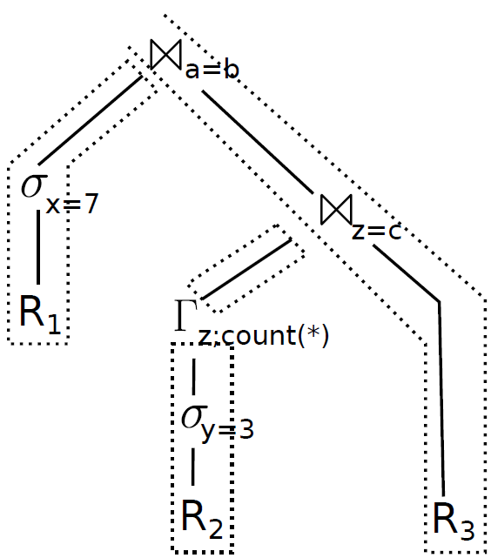
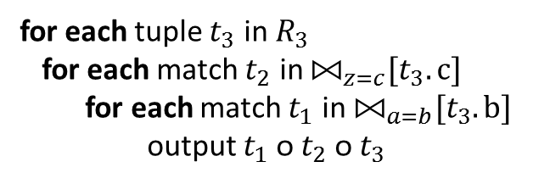
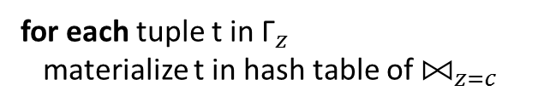
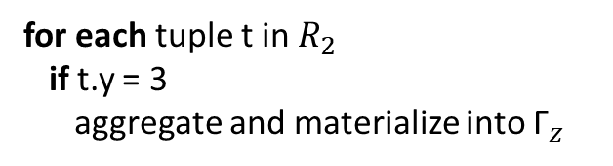
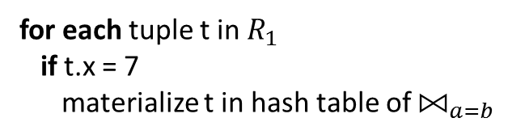
Generate code for plan [HyPer]
for each tuple t in $R_{1}$
if t.x = 7
materialize t in hash table of ${\text{⨝}}_{a=b}$
for each tuple t in $R_{2}$
if t.y = 3
aggregate and materialize into ${\text{Γ}}_{z}$
for each tuple t in${ \text{Γ}}_{z}$
materialize t in hash table of ${\text{⨝}}_{z=c}$
for each tuple $t_{3}$ in$R_{3}$
for each match $t_{2}$ in ${\text{⨝}}_{z=c}[t_{3}.c]$
for each match $t_{1}$ in ${\text{⨝}}_{a=b}[t_{3}.b]$
output $t_{1} \text{ᴏ}{ t}_{2} \text{ᴏ} t_{3}$
Operator boundaries blurred – Imperative execution
Notes:
The code consists of 4 parts that correspond to the pipeline fragments in the algebraic plan.
The ﬁrst fragment ﬁlters tuples from R1 and places them into the hashtable of Join a and b.
The second does the same for R2 and Γz, and the third transfers the results from Γz into the hashtable of Join z and c.
The fourth fragment passes the tuples of R3 along the join hash tables and produces the result.
All four fragments in themselves are strongly pipelining, as they keep their data in CPU registers and only access memory to retrieve new tuples or to materialize their results.
Small code fragments are working on large amounts of data in tight loops

Slide 51
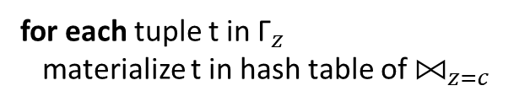
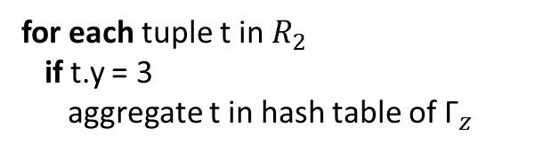
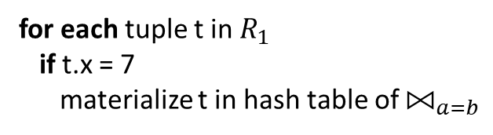
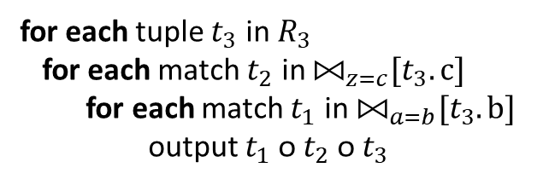
Push-based model for query compilation
Data pushed up the pipeline
Materializing only at pipeline breakers
No function calls in loops => Compiler distributes data to registers and increases cache reuse.
for each tuple t in $R_{1}$
if t.x = 7
materialize t in hash table of ${\text{⨝}}_{a=b}$
for each tuple t in $R_{2}$
if t.y = 3
aggregate t in hash table of ${\text{Γ}}_{z}$
for each tuple t in${ \text{Γ}}_{z}$
materialize t in hash table of ${\text{⨝}}_{z=c}$
for each tuple $t_{3}$ in$R_{3}$
for each match $t_{2}$ in ${\text{⨝}}_{z=c}[t_{3}.c]$
for each match $t_{1}$ in ${\text{⨝}}_{a=b}[t_{3}.b]$
output $t_{1} \text{ᴏ}{ t}_{2} \text{ᴏ} t_{3}$
Notes:
The way this concept is manifested is by using a push–based model.
In constrast to “compute centric” approach to database engine design. When the query execution engine wants to perform a computation on a tuple, the engine asks for it, and the tuple is pulled through the memory hierarchy and into the CPU.
The tuple currently processed is loaded into CPU registers,
All pipelining ancestor operators are applied,
And the tuple is materialized into the next pipeline breaker (e.g. hash join sides). Pipeline breaker is any operator causing data to be materialized, spilled in memory in our case, such as an aggregate operator, or a hash-join requiring a hashtable to be built.
The efficient implementation of such a model requires having code applied to register-based data.
In order to achieve such a fine-grained control of execution, the authors apply code generation techniques, relying on compiler infrastructure to dictate which values are placed in registers.

Slide 52
JIT compilation: The HyPer approach
HyPer goal: “Keep a tuple in CPU registers as long as possible”
Push data through execution plan
Blur operator boundaries
Generate code using LLVM
LLVM: Collection of modular and reusable compiler and toolchain technologies.
Core component is a low-level programming language (IR) that is similar to assembly.
Not all of the DBMS components need to be written in LLVM IR. → LLVM code can make calls to C++ code.
Notes:
Hyper produces code using the LLVM assembly language. By using LLVM we can even outperform hand-written code. LLVM allows for tricks which are hard to do using high-level languages such as C++. Furthermore, by using an established compiler framework, we beneﬁt from future compiler, code optimization, and hardware improvements.
One does not want to implement the complete query processing logic in LLVM assembler. First, because writing assembler code is more tedious than using a high-level language like C++, and second, because much of the database logic like index structures is written in C++ anyway. But one can easily mix LLVM and C++, as C++ methods can be called directly from LLVM and vice versa.
Goal of Hyper: The main idea is that processing is data centric and not operator centric. Data is processed such that we can keep them in CPU registers as long as possible.
Data is not pulled by operators but pushed towards the operators. This results in much better code and data locality

Slide 53
LLVM example: input and output
int mul_add(int x, int y, int z) {
return x * y + z;
}
define i32 @mul_add(i32 %x, i32 %y, i32 %z) {
entry:
%tmp = mul i32 %x, %y
%tmp2 = add i32 %tmp, %z
ret i32 %tmp2
}
Produced code very close to assembly
Compilation very fast (tens of milliseconds!)
Notes:
Here we see a simple LLVM example of a function that takes as input 3 integers and returns an arithmetic combination of them.
The LLVM IR is equivalent to the function.
This code can be then executed directly using the JIT compiler provided by LLVM.
LLVM is a full strength optimizing compiler, which produces extremely fast machine code.

Slide 54
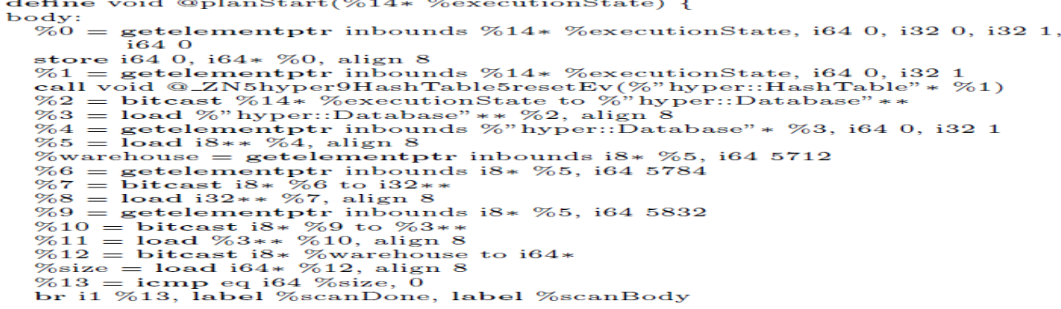
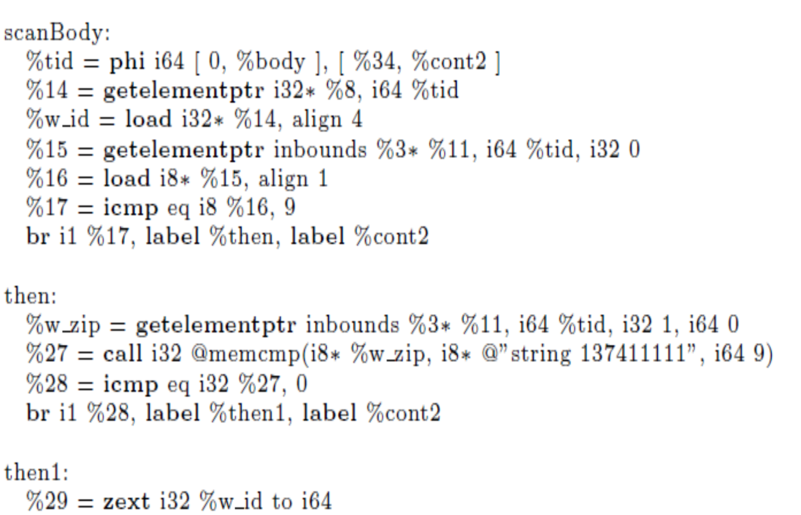
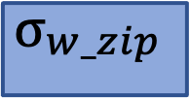

The Catch
select d_tax from warehouse, district where w_id=d_w_id and w_zip='…'
$$σ_{\begin{aligned}w_zip \\ \end{aligned}}$$
$$Warehouse$$
Notes:
[Point of the next three slides is to show that the generated code is long and thus error-prone/hard]
Here is the code for a simple query with one join and filter predicate. It involves a scan of both the relations with hashjoin. In this slide we can the see the LLVM code capturing the scan of warehouse relation along with filtering the tuples with w_zip. As can be seen the code is very close to assembly level code with commands like load, icmp, etc.
The scan body access all relation fragments, accesses all tuples contained in the current fragment, registers the required columns as available upon demand (they will be cached by the context). The selection just adds the attributes required for the predicate to the context and filters out all non-satisfying tuples.

Slide 55

(more)
select d_tax from warehouse, district where w_id=d_w_id and w_zip='…'
$$σ_{\begin{aligned}w_zip \\ \end{aligned}}$$
$$Warehouse$$
$$district$$
Notes:
The above code is for accessing the district relation.

Slide 56
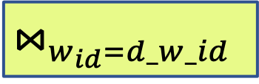
(Even more!)
select d_tax from warehouse, district where w_id=d_w_id and w_zip='…'
$$⋈_{w_{id}=d_w_id }$$
$$σ_{\begin{aligned}w_zip \\ \end{aligned}}$$
$$Warehouse$$
$$district$$
Low-level, error-prone coding
Notes:
A hash join is much more involved. The above is the snippet for the hash join for a pure main-memory scenario, and gets more complicated for the out-of-memory case.

Slide 57
Query compilation
Pipelined query processing without interpretation cost
Very painful to implement
BUT: Benefits have led major DBMS (and Spark!) to implement it

Slide 58



Processing over RAW data
Traditional DBMS: Data adapts to engine
Proteus Plug-in per data source
Generic-purpose scan operator
Specialize access paths to formats
Notes:
Until now we have seen how query compilation led us get significant performance benefits. Let us now see one more application of where code gen is useful.
The context is where a single engine needs to process data which are there in different formats eg: csv, bin, json, text, etc.
Well, the reason traditional database systems struggle with ad hoc data exploration is the nature of their query engines:
Data has always had to adapt to the engine via a costly loading step to then achieve top query performance. (data duplication)
Proteus: Develop plugin to read each data source and build auxiliary structures to process the data.
Can we do something better?
To treat each underlying dataset as native storage, we apply code generation to dynamically craft access paths at query time.
But why do we need these just-in-time access paths in the first place?
In other words, what’s wrong with this picture???
We change this paradigm by having a query engine adapt to the underlying raw data at query time.
We achieve this by generating file-format-specific plugins just-in-time.
Thus, we not only avoid the shortcomings related to data loading, but since we treat each heterogeneous dataset as a native storage format, we reduce the costs of repeated raw data accesses.
Specifically, costs are reduced because we are essentially hard-coding the implementation of each data scan to the underlying data.
Besides hard-coding each scan, the access paths may also utilize
positional caches, keeping binary positions of raw data fields, to reduce parsing costs and facilitate navigation for file formats such as CSV and JSON
In total, we aim for the best of both worlds: High-performance querying capabilities…. while keeping the original data formats and files.

Slide 59

Adapting to format
Unroll Columns
Data Types
Free navigation in files
$∀$col:
if col needed:
...
skipField();
skipRest();
//read field from file raw = readNextFieldFromFile(file) switch (schemaDataType[column]) case IntType: datum = convertToInteger(raw) case FloatType: datum = convertToFloat(raw)
fieldLength:10
tupleLength:100
Need fields 2 & 5 of 2nd row
moveTo(110);
readInt();
moveTo(140);
readFloat();
Notes:
In addition RAW exploits opportunities specific to each file format or file formats’ class, and optimizes generated code accordingly.
For example,
Unrolling of columns and handling each requested column separately instead of using a generic loop is appropriate for file formats with fields stored in sequence (like the previous CSV example)
For other formats, we can deterministically compute field positions in the raw files, and therefore spit out code with “hard-coded” attribute positions. If we have information such as the tuple and field lengths, we can locate attributes of interest without parsing and tokenizing the file
As a final example, for some more complex file formats the generated code can exploit potential embedded indexes, or, if a format is accompanied by a computational framework, make calls to it to enable optimizations like selection pushdown.
==============================================================
Q: WHY DOES THE ACCESS PATH HAVE TO BE GENERATED TO EXPLOIT INDEXES?
A: It’s not directly connected with JIT capabilities per se, it refers to how tight an integration with a file format you can achieve using RAW. The fact yet remains that RAW can create hybrid access paths based on all these capabilities; read sth of an index; read sth else sequentially; read sth from a cache; and add all this logic in one “hard-coded” operator
=================
As a final example, for some more complex file formats the generated code can exploit embedded indexes that are embedded to some file formats can be exploited by the generated access paths to speed-up accesses to the raw data, while some formats accompanied by computational frameworks enable optimizations like selection pushdown to the framework using the APIs exposed.
Other examples: identifier-based accesses + selection pushdowns
generally fewer computations at runtime.
• For hierarchical data formats, a JIT scan operator coupled with a query engine supporting a nested data model could be used to maintain the inherent nesting of some fields, or flatten some others, based on the requirements of the subsequent query operators. These requirements could be based on criteria such as whether a nested field is projected by the query (and therefore maintaining the nesting is beneficial), or just used in a selection and does not have to be recreated at the query output.

Slide 60
RAW™ NoDB Platform
Business
Intelligence
Data Cleaning
& Export
Data
Discovery
ML & AI
Data Preparation
Business
Applications
Single Query Engine
Unified Virtual Data Lake
Operational
Systems
Enterprise
Systems
Data
Warehouses
Data
Lakes
External
Sources
(Sensor data, Scada…)
(CRM, ERP, SCM…)
(Teradata, Oracle…)
(Hadoop, S3, Azure…)
(Social Media, Weather…)
Notes:
There is a commercial engine that has spawned from this technology. It is RAW labs which is there in the innovation park of the EPFL campus. There are building a general engine on top of spark. A single query engine that ingest data from various sources such as data warehouses, data lakes, other sources.
The support functionality such as BI, Data discovery, data preparation for ML, etc.

Slide 61
Conclusion
The processing model of a DBMS defines how the system executes a query plan.
Tuple-at-a-time via the iterator model
Query compilation
Vectorization model
Block-oriented model (typically column-at-a-time)
Hybrids do exist!!!

Slide 62
Reading material
COW Book chapters 12
M. Zukowski et al: MonetDB/X100 - A DBMS In The CPU Cache. IEEE 2005: https://ir.cwi.nl/pub/11098/11098B.pdf
T. Neumann: Efficiently Compiling Efficient Query Plans for Modern Hardware VLDB 2011: https://www.vldb.org/pvldb/vol4/p539-neumann.pdf

Slide 63
Backup Slides

Slide 64
Compilation cost
Notes:
Comparison not 100% fair, different hardware. But difference of 1 order of magnitude is huge, and not attributed to different hardware that is comparable. It is attributed to lower complexity!

Slide 65
Volcano iterator model
$$Γ_{sum}$$
r1
next()
Pull-based Interface: open/next/close
Tuple-at-a-time processing
Each operator produces a tuple stream
$$π$$
r1
next()
$$σ$$
r1
next()
$$Scan$$
r1
next()
R
Simple interface, pipelined execution
Notes:
The traditional method is the Volcano iterator model.
In the Volcano iterator model, the query is rewritten into a tree of operators representing actions such as selections, projections, and joins.
Every operator exposes the same pull-based interface, consisting of an open, next and close function call of an iterator.
When an operator issues a next call, it is forwarded to its children nodes, which again call next, and it results in a tuple being produced and returned upwards to the operator originally requesting it.
During query evaluation, each operator will therefore end up producing a tuple stream.
To sum up, Volcano offers a simple, intuitive interface, which also enables pipelined execution, in the sense that produced tuples from one operator can be generally be passed to the
parent operators without copying in another place in memory.
---------------------------------------------------------
* pipelining
pull-based
The time it takes to call a virtual member function is a few clock cycles more than it takes to call a non-virtual member function, provided that the function call statement always calls the same version of the virtual function. If the version changes then you will get a misprediction penalty of 10 - 30 clock cycles. The rules for prediction and misprediction of virtual function calls is the same as for switch statements...

Slide 66
Volcano CPU costs
[Graefe]
Control flow constantly changing
Many (virtual) function calls
Branch mispredictions
“Real Work” a fraction of total execution
Notes:
However, the very abstractions that make the Volcano iterator model so simple also penalize its performance..
As multiple function calls are needed per each tuple handled by an operator, this results in a very large number of function calls.
These function calls also lead to branch mispredictions, as they are either typically either virtual or made through a function pointer.
In addition, the fact that the control flow is constantly changing leads to poor code locality.
The result of all these is that the real work that needed to be done to evaluate the query, ends up being only a fraction of the total execution cost.
THE ITERATOR INTERFACE DOES NOT CONTROL THE FLOW OF PIPELINED OPERATORS
-------------------------------------------------------------
They also can’t be inlined.
Hard to predict because of indirect jump
Cause two data cache misses and one instruction cache miss in the worst case
-------------------------------------------------------------
One function call per tuple for each operator => Costly
Abstract nature => Virtual calls
Control flow constantly changing => Poor locality [the working set of instructions being executed is large]
The time it takes to call a virtual member function is a few clock cycles more than it takes to call a non-virtual member function, provided that the function call statement always calls the same version of the virtual function. If the version changes then you will get a misprediction penalty of 10 - 30 clock cycles. The rules for prediction and misprediction of virtual function calls is the same as for switch statements...
On the contrary: Very good code locality if small code fragments are working on large amounts of data in tight loops
millions of virtual function calls
control flow constantly changes between operators => Code locality issues
branch prediction and cache locality suffer
Poor Code Locality
Frequent L1 instruction cache misses indicate potential opportunities to improve performance by reducing the working set of instructions being executed; in other words by improving code locality.

Slide 67
Vectorized Query Execution
[Zukowski]
$$Γ_{sum}$$
Column-store implementation
Iterators return blocks
$$π$$
Pros | Cons
Fewer next() calls | Materializing costs
Good locality
Less branching
$$σ$$
$$Scan$$
R
Efficient control flow, but wasteful to bandwidth
Notes:
An attempt to reduce these costs came from the world of column stores.
The intuition is that the input of each operator is not a tuple, but a block of values.
In the extreme case that is met in traditional column stores, the entire columns of data are provided as input to each operator.
The effect of this technique is that next() calls of the iterators are fewer, or even reduced to only one call as in column stores,
better locality is achieved as small pieces of code operate over multiple data values, and the amount of branching is also reduced.
On the other hand, it is now harder to pipeline entire blocks of values, therefore materializing increases the amount of memory required for evaluation.
What the authors of this work argue is that a new approach is needed, offering the performance benefits of vectorized execution, w/o sacrificing pipelining capabilities.
(How? No degrees of freedom + Less branches in actual code. Also opt for data dependencies vs branches. Not always a clear winner)
------------------------------------------------
control dependencies can be converted into data dependencies by treating the result of the comparison as a variable [21]. Second, comparison results can be used as masks for subsequent operations [24]. We call this general approach nullification and illustrate it by rewriting the loop above as:
equal = (key != table[hash].key ? 1 : 0) - 1;
table[hash].count -= equal;
table[hash].sum += value & equal;
------------------------------------------------
Combine columnar execution + Volcano model
Difficult to pipeline

Slide 68
Generic code is more and slower!
Source:
PhD thesis of
K. Krikellas
Notes:
How can we improve these issues of interpretation.
Problem arises because of generic code and because of extensive use of function calls!
type-specific code:
Function calls are eliminated! read_tuple and getting a particular attribute becomes simple arithmetics over the in-memory page data
predicate check becomes a single line/again no function call!
Matches(…) is generic code → inside matches(….) we have lot of code for type checking & casting/also expensive but can be avoided because we know the expected types at the time of query!

Slide 69
Exercise:
Compare the two code snippets.
Which is better? Why?
Source:
PhD thesis of
K. Krikellas

Slide 70
Push-based model for query compilation
Data pushed up the pipeline
Materializing only at pipeline breakers
No function calls in loops => Compiler distributes data to registers and increases cache reuse.
Execute without “spilling data to memory”
Notes:
The way this concept is manifested is by using a push – based model.
The tuple currently processed is loaded into CPU registers,
All pipelining ancestor operators are applied,
And the tuple is materialized into the next pipeline breaker (e.g. hash join sides). Pipeline breaker is any operator causing data to be materialized, spilled in memory in our case, such as an aggregate
operator, or a hash-join requiring a hashtable to be built.
The efficient implementation of such a model requires having code applied to register-based data.
In order to achieve such a fine-grained control of execution, the authors apply code generation techniques, relying on compiler infrastructure to dictate which values
are placed in registers.
----------------------------------------------------------------------------------------------------------------------
Pipeline breaker: they cause values to be evicted from registers and “spilled to memory. Don’t allow pipelining
How to get all this fine grained control? How not to have a function call ruining everything?
“Hot Path of execution”
The complex part of the query processing (e.g., complex data structure management or spilling to disk) is written in C++, and forms the cogwheels
Generate code to handle tuple processing
Complex code pieces unchanged
-------------------------------------------------

Slide 71
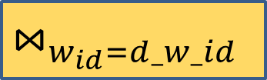

The Catch
select d_tax from warehouse, district where w_id=d_w_id and w_zip='…'
$$⋈_{w_{id}=d_w_id }$$
$$σ_{\begin{aligned}w_zip \\ \end{aligned}}$$
$$Warehouse$$
$$district$$
Notes:
Here is the code for a simple query with one join and filter predicate. It involves a scan of both the relations with hashjoin. In this slide we can the see the LLVM code capturing the scan of warehouse relation along with filtering the tuples with w_zip. As can be seen the code is very close to machine level code with commands like load, icmp, etc.
The scan body access all relation fragments, accesses all tuples contained in the current fragment, registers the required columns as available upon demand (they will be cached by the context). The seletion just adds the attributes required for the predicate to the context and filters out all non-satisfying tuples.

Slide 72
(more)
select d_tax from warehouse, district where w_id=d_w_id and w_zip='…'
$$⋈_{w_{id}=d_w_id }$$
$$σ_{\begin{aligned}w_zip \\ \end{aligned}}$$
$$Warehouse$$
$$district$$
Notes:
The above code is for accessing the district relation.

Slide 73
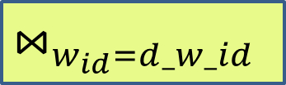
(Even more!)
select d_tax from warehouse, district where w_id=d_w_id and w_zip='…'
$$⋈_{w_{id}=d_w_id }$$
$$σ_{\begin{aligned}w_zip \\ \end{aligned}}$$
$$Warehouse$$
$$district$$
Low-level, error-prone coding
Notes:
A hash join is much more involved. The above is the snippet for the hash join for a pure main-memory scenario, and gets more complicated for the out-of-memory case.

Slide 74



From query plan to code
SELECT COUNT(*) FROM Sailors
WHERE age < 20
$$Δ^{sum}$$
$$σ_{age<20}$$
$$Sailors$$
Notes:
Now that we have described all the components, let’s see how they fuse together for each incoming query.

Slide 75
From query plan to code
SELECT COUNT(*) FROM Sailors
WHERE age < 20
$$Δ^{sum}$$
$$σ_{age<20}$$
$$Sailors$$
while() {
}

Slide 76
From query plan to code
SELECT COUNT(*) FROM Sailors
WHERE age < 20
$$Δ^{sum}$$
$$σ_{age<20}$$
$$Sailors$$
while(!eof(Sailors)) { read(age)
}

Slide 77
From query plan to code
SELECT COUNT(*) FROM Sailors
WHERE age < 20
$$Δ^{sum}$$
$$σ_{age<20}$$
$$Sailors$$
while(!eof(Sailors)) { read(age)
if() {
}
}

Slide 78
From query plan to code
SELECT COUNT(*) FROM Sailors
WHERE age < 20
$$Δ^{sum}$$
$$σ_{age<20}$$
$$Sailors$$
while(!eof(Sailors)) { read(age)
if(eval(age < 20)) {
}
}

Slide 79
From query plan to code
SELECT COUNT(*) FROM Sailors
WHERE age < 20
$$Δ^{sum}$$
$$σ_{age<20}$$
$$Sailors$$
while(!eof(Sailors)) { read(age)
if(eval(age < 20)) {
sum += 1
}
} return out(sum,json)

